Slide 1

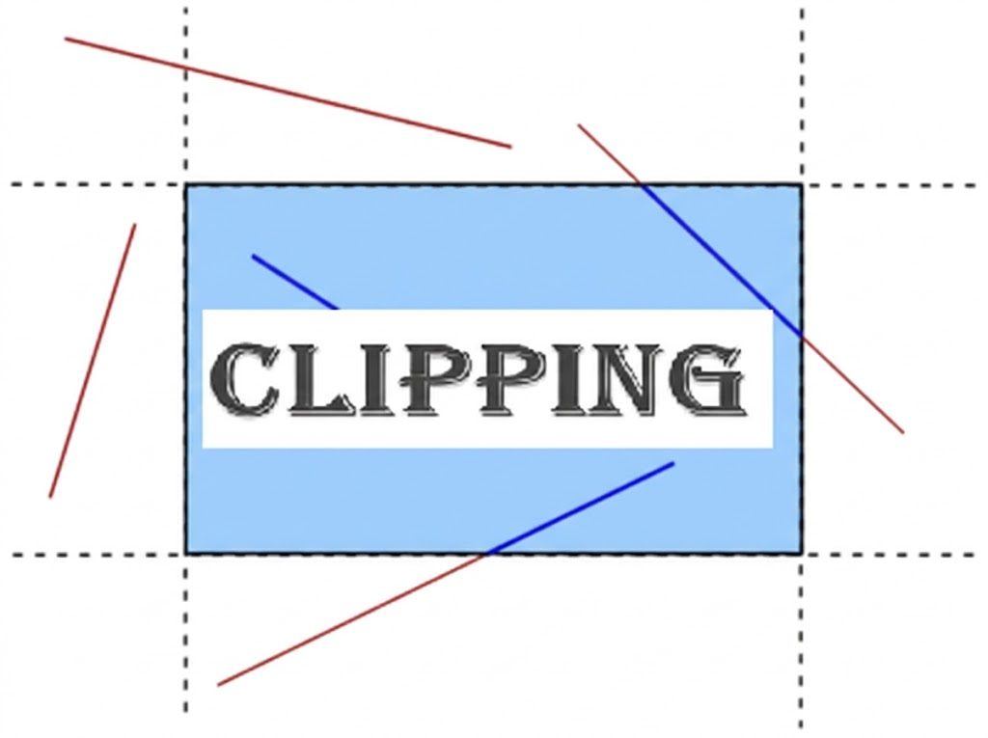
Computer Graphics Line Clipping
Lecture 11
Syada Tasmia Alvi
Senior Lecturer Department of Computer Science and Engineering Daffodil International University, DIU
‹#›
Notes:
‹#›

Slide 2
Clipping
When we have to display a large portion of the picture, then not only scaling & translation are necessary, but also the visible part of the picture is identified. This process is not easy. Certain parts of the image are inside, while others are partially inside.
For deciding the visible and invisible portion, a particular process called clipping is used. Clipping determines each element's visible and invisible portion. The visible portion is selected. An invisible portion is discarded.
Department of CSE, Daffodil International University
‹#›

Slide 3
Types of Clipping:
Point Clipping
Line Clipping
Area Clipping (Polygon)
Curve Clipping
Text Clipping
Exterior Clipping
Department of CSE, Daffodil International University
‹#›

Slide 4
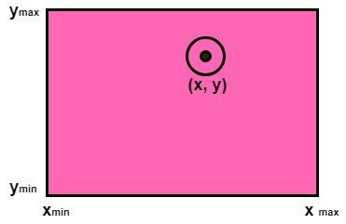
Point Clipping
Point clipping is used to determine whether the point is inside the window or not. For this the following conditions are checked.
x ≤ xmax
x ≥ xmin
y ≤ ymax
y ≥ ymin
The ( x, y) is the coordinate of the point. If any one of the above inequalities is false, then the point will fall outside the window and will not be considered to be visible.
Department of CSE, Daffodil International University
‹#›

Slide 5
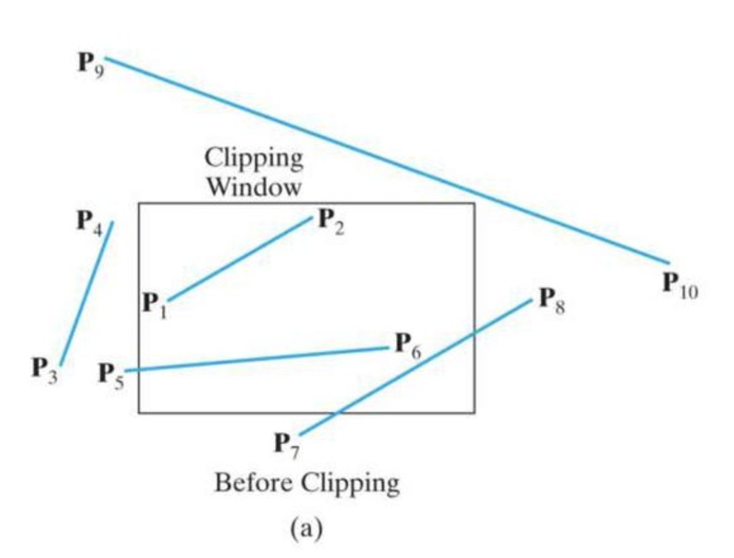
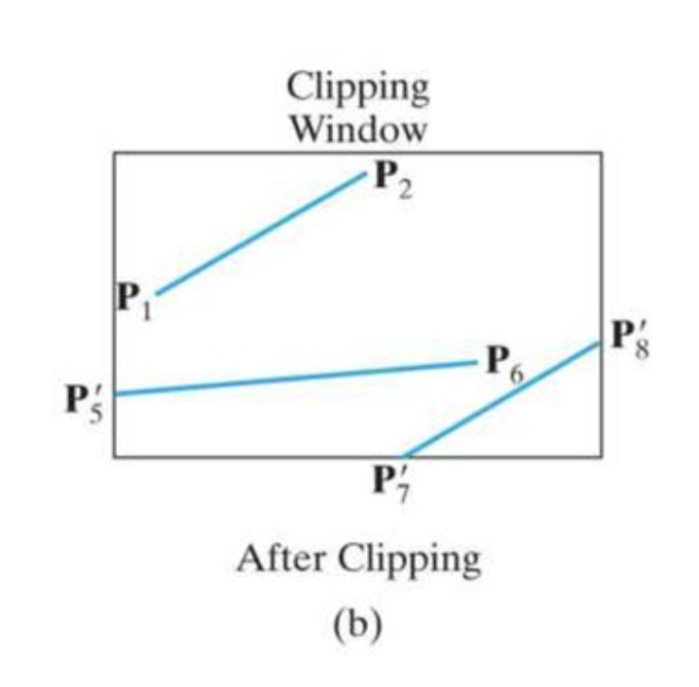
Line Clipping
The concept of line clipping is the same as point clipping. In line clipping, we will cut the portion of the line that is outside of the window and keep only the portion that is inside the window.
Lines are of three types:
Visible: A line or lines entirely inside the window is considered visible
Invisible: A line entirely outside the window is considered invisible
Clipped: A line partially inside the window and partially outside is clipped. For clipping point of intersection of a line with the window is determined.
Department of CSE, Daffodil International University
‹#›

Slide 6
Line clipping algorithms
The line clipping algorithms are:
Cohen-Sutherland Line Clipping Algorithm
Midpoint Subdivision Line Clipping Algorithm
Liang-Barsky Line Clipping Algorithm
Department of CSE, Daffodil International University
‹#›

Slide 7
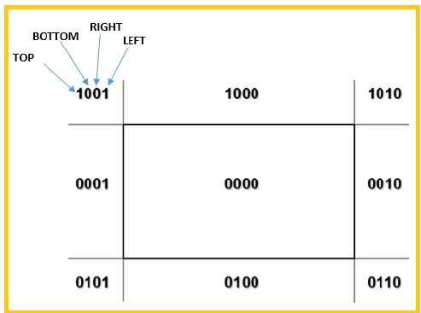
Cohen-Sutherland Line Clipping Algorithm
Cohen-Sutherland Method [Widely used].
In this method, region codes are used to identify the position of line endpoints relative to the rectangular clipping window.
Department of CSE, Daffodil International University
‹#›

Slide 8
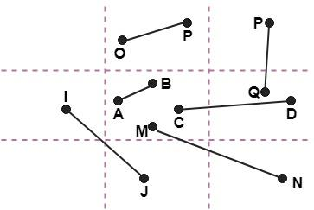
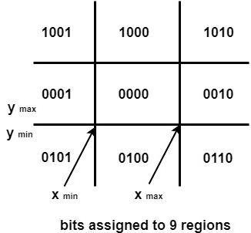
Cohen-Sutherland Line Clipping Algorithm
Problem 1: The following figure show lines of various types
Line AB is the visible case
Line OP is an invisible case
Line PQ is an invisible line
Line IJ are clipping candidates
Line MN are clipping candidate
Line CD are clipping candidate
Department of CSE, Daffodil International University
‹#›

Slide 9
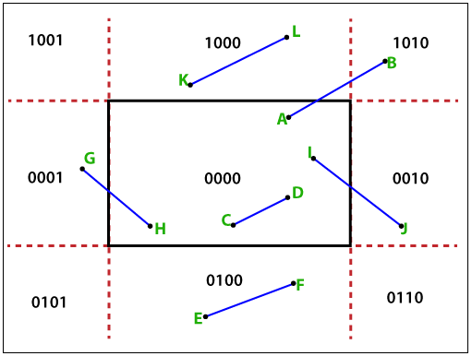
Cohen-Sutherland Line Clipping Algorithm
Problem 2: In the below-mentioned example, we have different lines. The different category of the line—
Line AB is a clipped case.
The line CD is completely visible.
Line EF is completely invisible.
Line GH is a clipped case.
Line KL is completely invisible.
Line IJ is a clipped case.
Department of CSE, Daffodil International University
‹#›

Slide 10
Cohen-Sutherland Line Clipping Algorithm
Step 1: Calculate positions of both endpoints of the line
Step 2: Perform OR operation on both of these end-points
Step 3: If the OR operation gives 0000
Then
line is considered to be visible
else
Perform AND operation on both endpoints
If And ≠ 0000
then the line is invisible
else
And=0000
Line is considered the clipped case.
Step 4: If a line needs to be clipped, first find an intersection point of all boundaries with the following formula:
m = (y2-y1) (x2-x1)
Department of CSE, Daffodil International University
‹#›

Slide 11
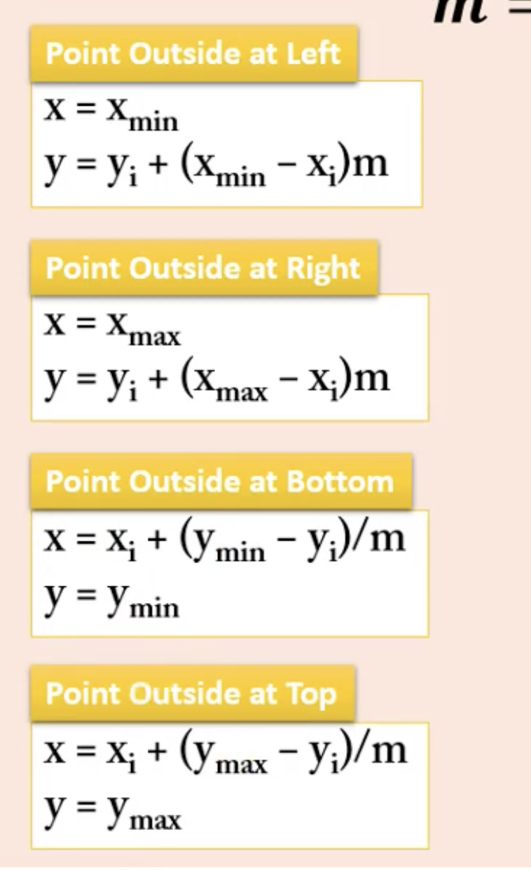
Cohen-Sutherland Line Clipping Algorithm
Step 5: Finding intersection points
i) y value of vertical line :
When the line intersects the left-side boundary of the window port.
y = y1 + m(x - x1)
Here x = xmin (Minimum value of x coordinate)
When the line intersects the right-side boundary of the window port.
y = y1 + m(x - x1)
Here x = xmax (Maximum value of x coordinate)
ii) x value of horizontal line:
When the line intersects Top side boundary of the window port.
x = x1 + (y - y1)/m
Here y = ymax (Maximum value of y coordinate)
When the line intersects the bottom side boundary of the window port.
x = x1 + (y - y1)/m
Here y = ymin (Minimum value of y coordinate)
Department of CSE, Daffodil International University
‹#›

Slide 12
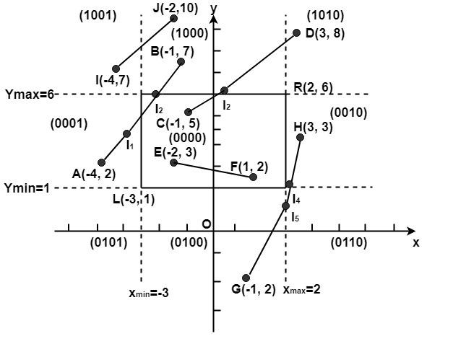
Example of Cohen-Sutherland Line Clipping Algorithm:
Let R be the rectangular window whose lower left-hand corner is at L (-3, 1) and whose upper right-hand corner is at R (2, 6). Find the region codes for the endpoints in fig.
Department of CSE, Daffodil International University
‹#›

Slide 13
Example of Cohen-Sutherland Line Clipping Algorithm:
The region code for point (x, y) y) is set according to the scheme
A (-4, 2)→ 0001 F (1, 2)→ 0000
B (-1, 7) → 1000 G (1, -2) → 0100
C (-1, 5) → 0000 H (3, 3) → 0010
D (3, 8) → 1010 I (-4, 7) → 1001
E (-2, 3) → 0000 J (-2, 10) → 1000
We place the line segments in their appropriate categories by testing the region codes found in the problem.
Category 1 (visible): EF since the region code for both endpoints is 0000.
Category 2 (not visible): IJ since (1001) AND (1000) = 1000 (which is not 0000).
Department of CSE, Daffodil International University
‹#›

Slide 14
Example of Cohen-Sutherland Line Clipping Algorithm:
Category 3 (candidate for clipping):
AB since,
(0001) AND (1000) = 0000,
CD since,
(0000) AND (1010) =0000, and
GH. since (0100) AND (0010) =0000.
The candidates for clipping are AB, CD, and GH.
Department of CSE, Daffodil International University
‹#›

Slide 15
Example of Cohen-Sutherland Line Clipping Algorithm:
For Clipping AB,
A (-4, 2), B (-1, 7)
x1= -4, y1= 2
x2= -1, y2= 7
m = (7-2) / (-1+4) = 5/3
In case of A,
A is outside the window, and the line intersects the left-side boundary of the window port.
Here, xmin=-3.
y = y1 + m(x-x1) = 2 + 5/3 (-3+4) = 11/3
The resulting intersection point is I1 (-3,11/3) or (-3,3)
In case of B,
B is outside the window (i.e., its code is 1000)
the line that intersects the top-side boundary of the window port. ymax=6.
x0 = x1+(y-y1)/m = - 4 + (6-2)* 3 /5 = -4+12/5 = -8/5 = -1
Department of CSE, Daffodil International University
‹#›

Slide 16
Example of Cohen-Sutherland Line Clipping Algorithm:
For clipping CD,
C (-1, 5) , D (3, 8)
x2=-1 y2=5
x1=3 y1=8
m= (5-8)/(-1-3)= 3/4
we start with D since it is outside the window. Its code is 1010.
The line intersects Top side boundary of the window port. y_{max}=6.
x = x1+(y-y1)/m = 3+(6-8)*4/3 =3-8/3= 9-8/3 = ⅓
y_{max}=6. The resulting intersection I₃ is (1/3,6),and its code is 0000.
Department of CSE, Daffodil International University
‹#›

Slide 17
Example of Cohen-Sutherland Line Clipping Algorithm:
For clipping GH,
we can start with either G or H since both are outside the window.
G (1, -2) , H(3,3)
m= (3+2)/(3-1) = 5/2
In case of G,
the line intersects the bottom side boundary of the window port.
x0 = x1+(y-y1)/m = 1+ ((1+2)*2)/5 = 1+6/5 =11/5 =2.2
The code for G is 0100 line y_{min}=1.
The resulting intersection point is I₄ (2,1) and its code is 0010. We clip GI₄ and work on I₄ H. Segment I₄ H is not displaying since (0010) AND (0010) =0010.
Department of CSE, Daffodil International University
‹#›

Slide 18

Department of CSE, Daffodil International University
‹#›
Notes:
‹#›

